Slide 1
NIHI CHATBOT
ASSISTANT

Slide 2
Content
What is chatbot?
How does it work?
Natural Language Processing
Library used in Nihi Chatbot
Benefits
Technology

Slide 3
What is CHATBOT?
In Simple word chatbot is a Computer Program that is designed to communicate with human by a text or voice throught the internet.
Chatbot are virtual assistant programmed to automatically answer users requests.

Slide 4
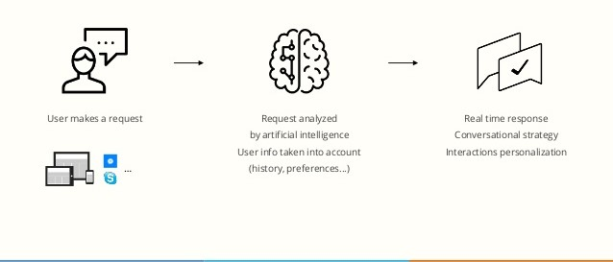
How does it work?

Slide 5
Natural Language Processing(NLP)
Natural Language processing(NLP) is the abiltity of a com- puter program to understand human speech as it is spoken. NLP is a component of artificial intelligence.
It makes computer to perform useful tasks with the natural language human use.
The input and output of an NLP system can be-
Speech
Written Text

Slide 6
Library used in NIHI Chatbot
Pyttsx3
Speech Recognition
Datetime
Web-browser
Wikipedia

Slide 7
Pyttsx3:
Pyttsx3 is a text to speech conversion library in python.
Wikipedia:
It is a python library that make it easy to access and parse data from wikipedia.
Webbrowser:
It provides a interface for display the user queries solution .

Slide 8
Benefits
Immediate answers.
Available 24/hr.
Innovation Customer Service.
Multi- Channel Consistency.
Simplify Employees Life.

Slide 9
Technology
Python
Visual Studio(Editor)

Slide 10
THANKYOU

